Slide 1
Taking inputs from the user
Group G(Prajna C, sandhya, pooja kadam)

Slide 2
Command we use is read
Syntax : read <input variable>
Ex program:
read input1
echo "$input1"

Slide 3
read with -p
Syntax : read –p PROMPT <input variable>
Ex program:
read –p "Lets take an input" input1
echo "$input1"

Slide 4
read with -sp
Syntax : read –sp PROMPT <input variable>
Ex program:
read –sp "Lets take an input secretly" input1
echo "$input1"

Slide 5
read with -a
Syntax : read -a <array_name>
Ex program:
read –a "Lets take input as an array" input1
for var in $input1
do
Echo "$var"
done

Slide 6
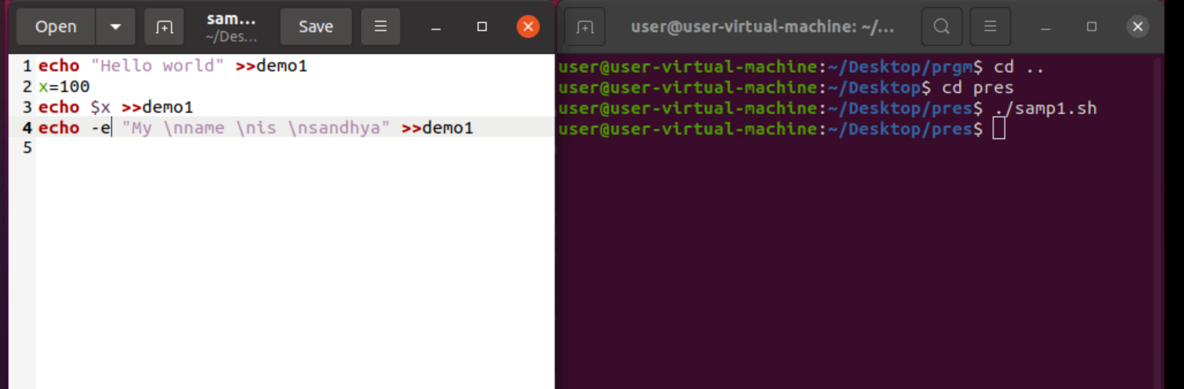
Printing the output on the file

Slide 7
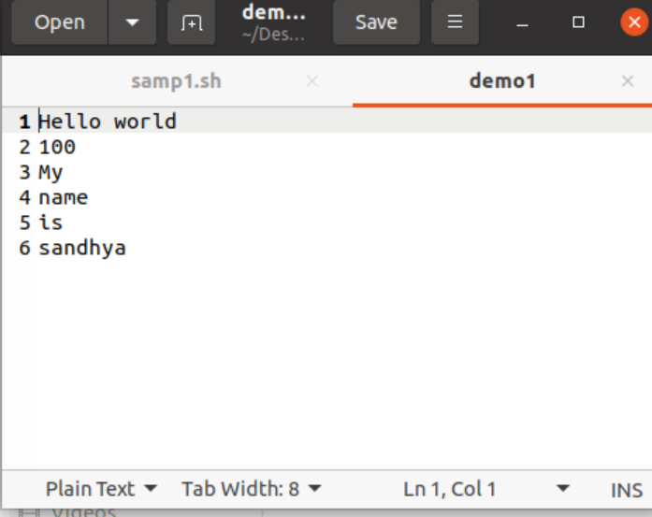
Output of Samp1.sh

Slide 8
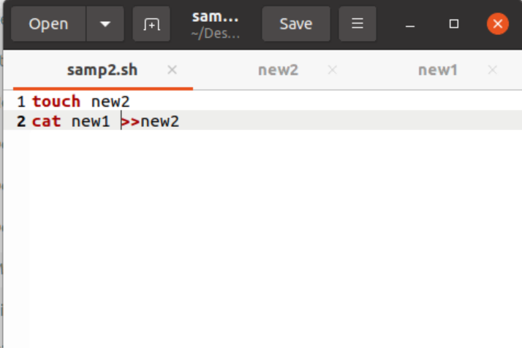
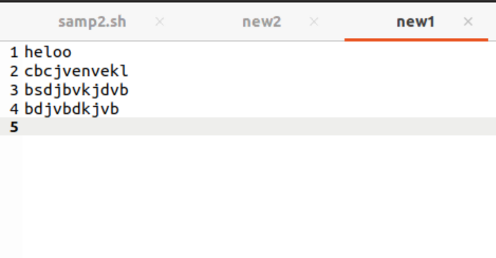
Samp2.sh
new1.txt

Slide 9
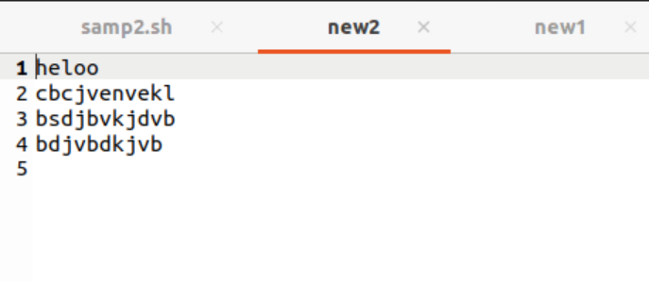
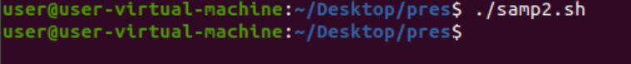
new2.txt

Slide 10
Outputs on console​
Using echo​
Echo "string"​
Ex:echo –e "hello \tbatch 86 \ti \tam \tinux" - ​
-e = Use dto detect \ and variable.​
\t- = Used to add tab.​
\n = Used to print output on new slide.​
\v = It gives vertical tab​
\b = It is used to remove spaces.​
​
Using printf​
Printf "string"​
Ex:Printf "%d \n" 2.55 oxff 0324 3.5​
%d = It is used to print integer value.​
%f = it is used to print float value.​
​

Slide 11


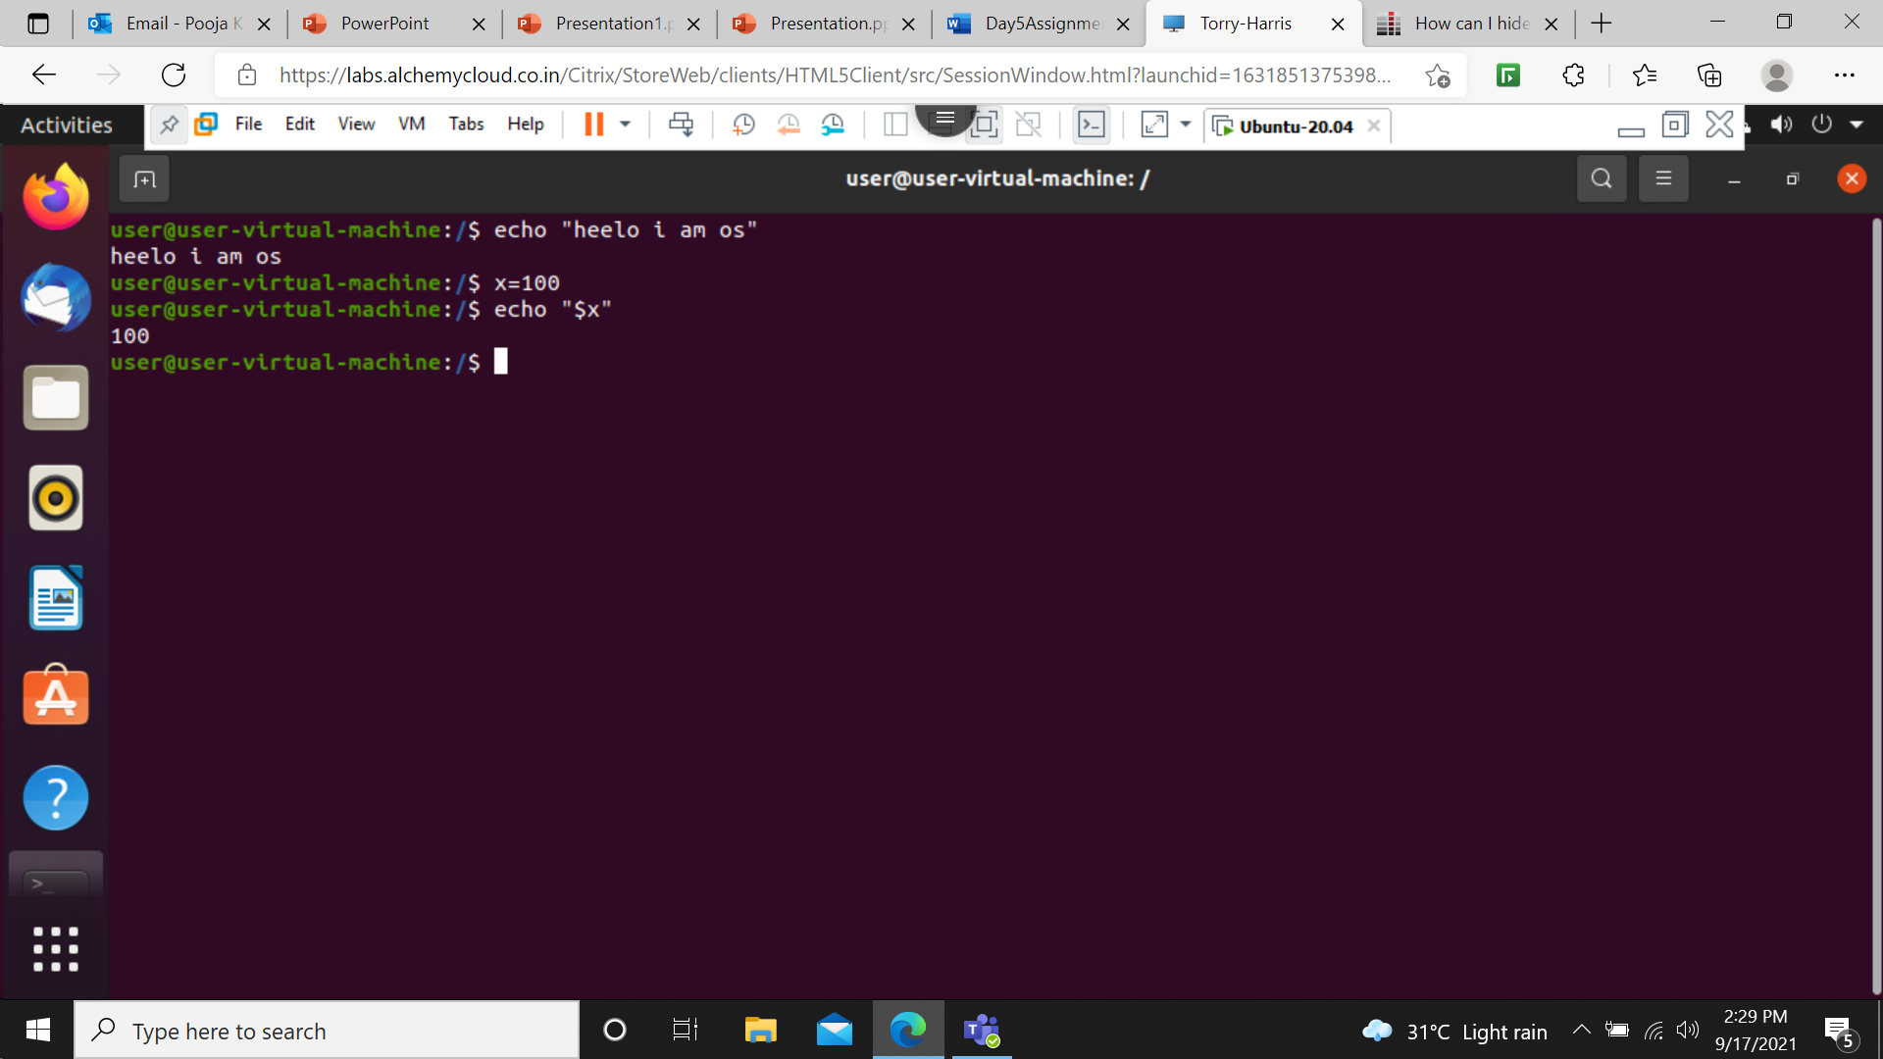



echo "$x"- This command is used to print the value of variable.

Slide 12
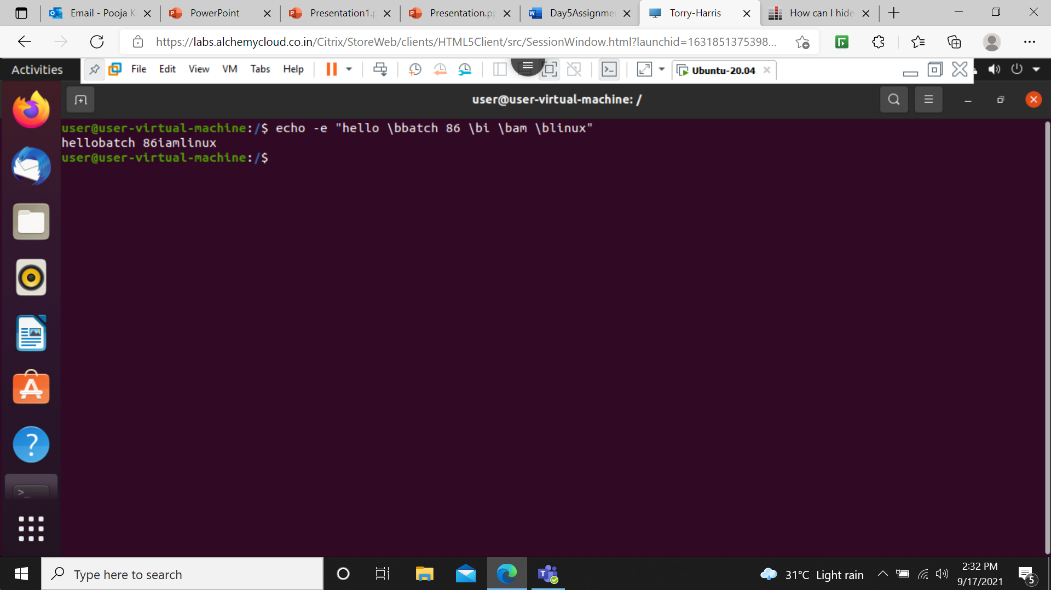
echo –e "hello \bbatch 86 \bi \bam \blinux" - This command is used to remove the space wherever \b is present.

Slide 13
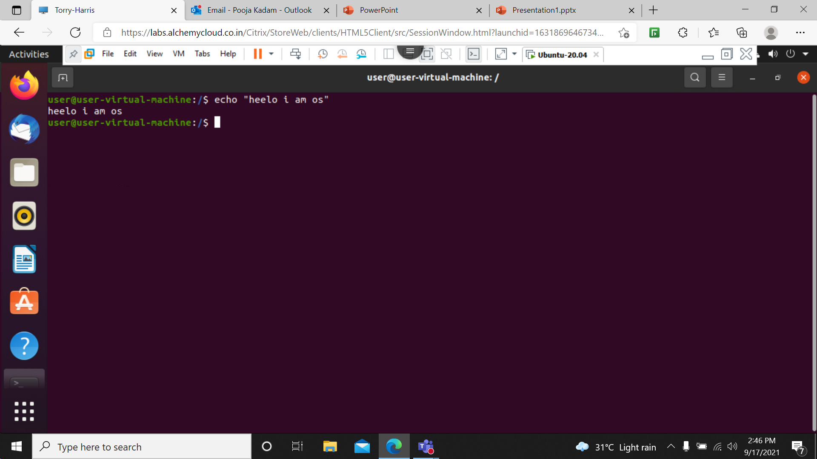
echo "write " - this command is used to print on console.

Slide 14
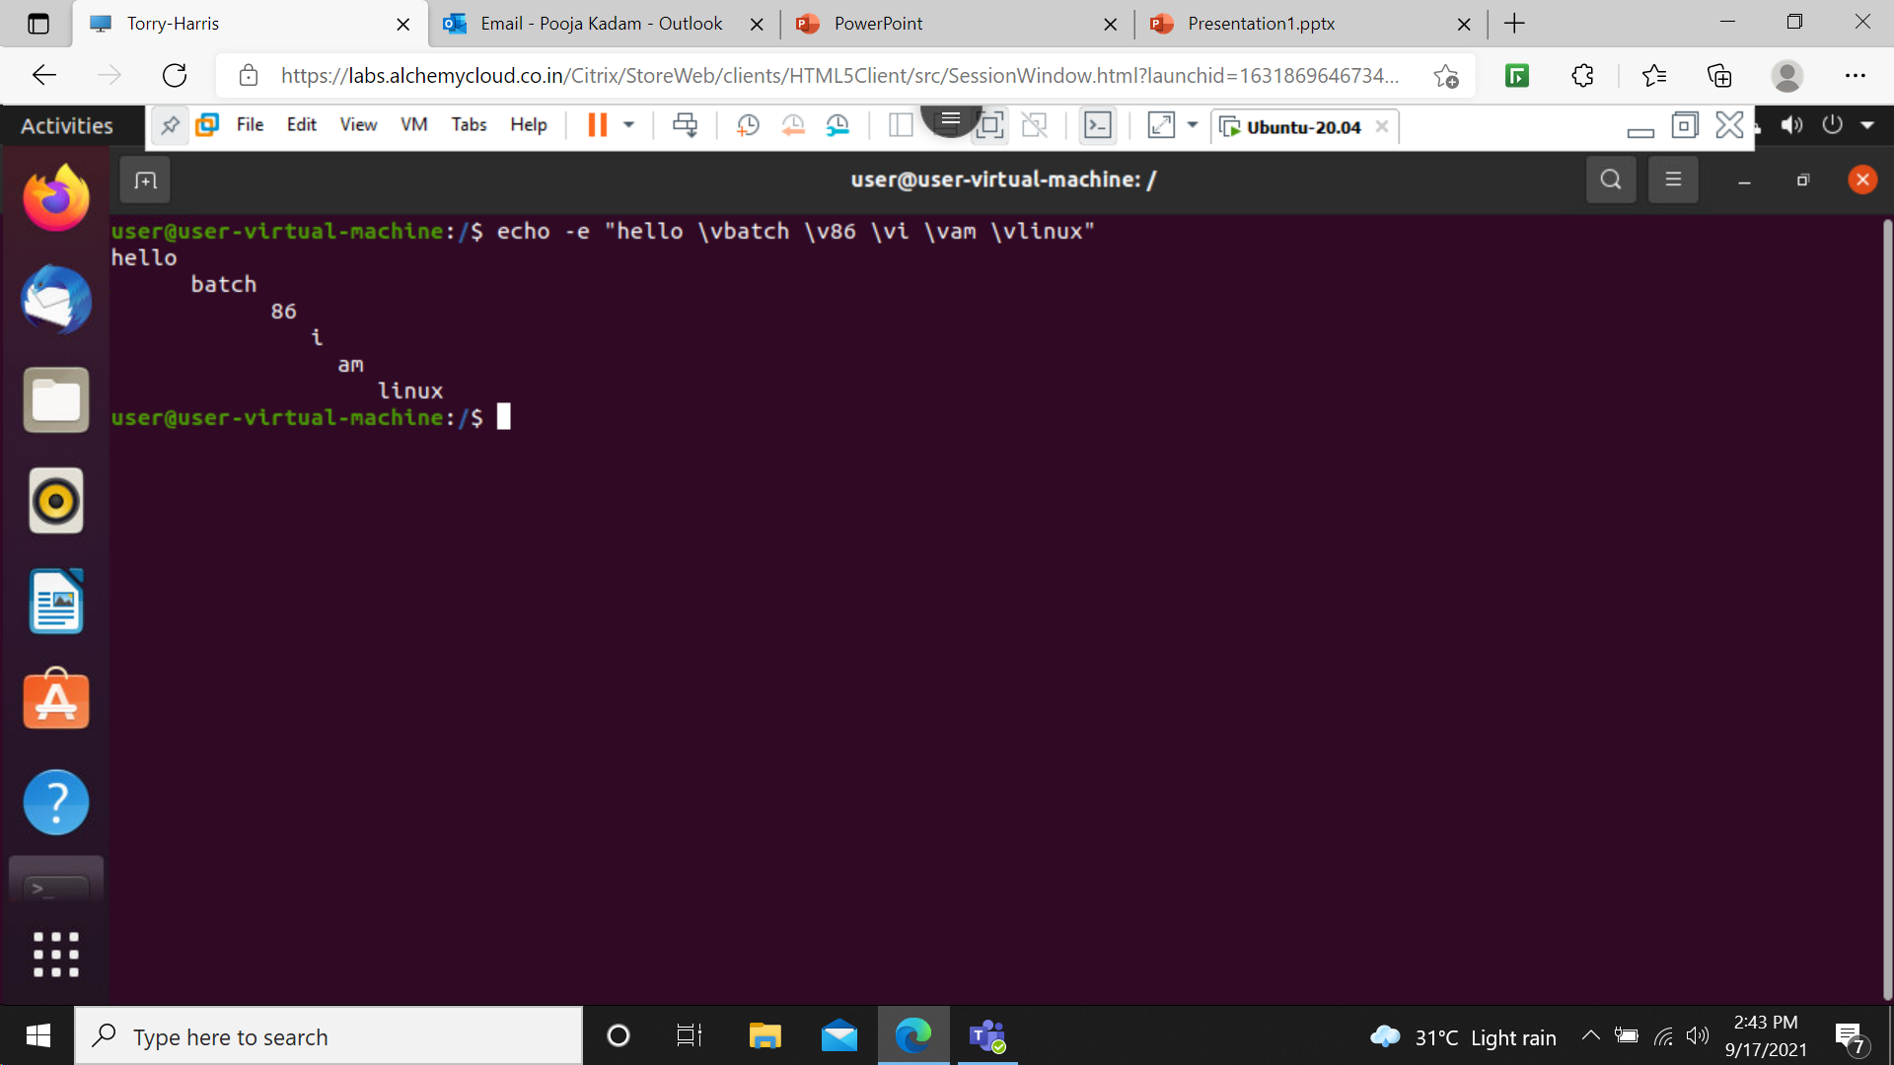
echo –e "hello \vbatch 86 \vi \vam \vlinux" - This will give a vertical tab wherever \v is present.

Slide 15

echo –e "hello \nbatch 86 \ni \nam \nlinux" - This command is used to print output on new line wherever \n is present.

Slide 16
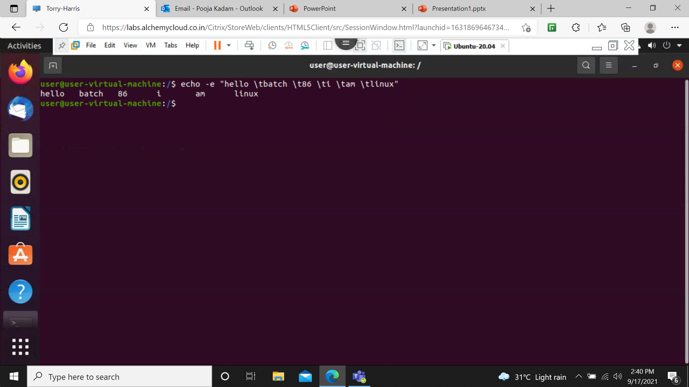
echo –e "hello \tbatch 86 \ti \tam \tinux" - This command is used to give tab wherever \t is present.

